Slide 1
Membership Renewal Checklist

Slide 2
2025 Membership Renewal Checklist
Step 1 – Update club roles for your Club/Zone
Step 2 – Update 2025 Membership Fees
Step 3 – Review additional Membership approval restrictions
Step 4 – Update Family Membership Fees
Step 5 – 14 Months Membership
Step 6 – How to add life members

Slide 3
How to update roles in the system?
The first step is to update the club roles in the system. Only relevant roles should be listed in the members’ profiles. Any change in club admin access should be updated in the system. This also includes revoking club admin access to previous club administrators or committee members.
Click on the Club Members tile and search for the member.
Click on Profile and click on “Club Roles”
Click on “Update Roles”

Slide 4
How to update roles in the system?
By clicking on the “Club Administrator checkbox”, the member will have club admin access. To revoke a member’s club admin access simply untick the Club Administrator’s checkbox. Other roles can also be updated using the same process.

Slide 5
Updating 2025 Membership Prices
Membership prices for all clubs and zones can only be updated during the “Blackout Period”. During this period all the memberships at the club and zone levels will be deactivated and will not be available for purchase.
The blackout Period dates are decided by the state bodies to provide clubs and zones with sufficient time to update their membership prices. The blackout period is from 1st November 2024 – 11th November 2024 for all WA clubs.
PCA Membership Fee for all Riding Memberships is $84.26 (GST Inclusive). This fee includes insurance premiums.
PCA Membership Fee for all Non-riding Membership is $0
PCA Membership Fee for Come & Try Membership is $11 (GST Inclusive)
State Membership Fee for Riding Memberships:
Ready to Ride______ $55.00;
Junior/Senior ______ $140.00; and
Adult Rider________ $158.00.
State Membership Fee for Come & Try Membership is $19.00
State Membership Fee for Supporter Membership is no charge.
State membership categories available this year are as follows: Supporter (non-riding), Ready to Ride, Junior, Senior and Adult Riding and Come & Try day membership for rallies and camps. ***Please note that One Event competition day memberships are through the state direct only, 18 years and over.

Slide 6
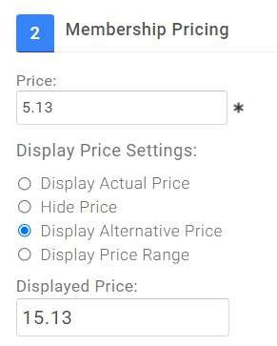
Updating 2025 Membership Prices
Click on Membership Setup. A list of all membership categories available for your club will be displayed.
Click on the edit pencil (edit membership). Scroll down to section 2.
The first text box (indicated with RED arrow) is where clubs and zones need to put in THEIR membership fees. This is not the total fees but only your portion.
Display Price Setting should be set to DISPLAY ALTERNATIVE PRICE.
The displayed Price is the Total Membership Fee. This fee should include PCA Fess + State Fees + Zones Fees + Club Fees. This fee needs to be manually calculated. Please contact relevant organisations for their membership fees. PCA and State fees can be found in the previous slide.

Slide 7
Updating 2025 Membership Prices
Once the membership prices are updated. Please check the “Automatically Pro-Rata checkbox”. This check box can be found under “Price”.
Based on the club/zone preference, please tick or untick the box.
Please note: Pro-rata option will only come up if the membership validity is set in Years. The Pro-rata price is calculated DAILY and NOT MONTHLY

Slide 8
Updating 2025 Membership Prices
Next we scroll down to Section 5 – Restrictions, Discounts and Surcharges.
Restrictions – All the restrictions are configured at the state level. Clubs and zones do not have to set up any new restrictions. Please review the current restrictions for any questions or concerns, contact Pony Club Australia.
Discounts – Please check and update the discount rules. Membership upgrade rules also need to be upgraded. For example, membership upgrade rules for riders upgrading from non-riding membership to riding membership. If your club membership fees have changed this year, then you will have to update the subsequent discount rules too. Please refer to the Managing Upgrades user guide for any questions relating to upgrades.
Link: https://ponyclubaustralia.com.au/wp-content/uploads/2020/06/Defining-Membership-Upgrade-Discounts-PCA.pdf If you’re unsure about this, please contact PCA or your state body.
Surcharges – Please review if there are any active surcharges for the club or zone.
Please click on save once all the prices and settings have been updated.

Slide 9
Updating 2025 Membership Prices
Once you have clicked on “Save”. The system will redirect you to the Membership Overview page.
The last thing to do is to make the membership “Active”. To do this click on the “Dropdown Arrow” and click “Active”. Memberships need to be made active to allow members to purchase memberships. Please note – 1. Active option and others are in grey font and are NOT greyed out. 2. Only after the Blackout Period, members will be able to buy any club membership even if they have activated and set up the membership prices for 2025 at the club level. 3. Please also check the “Instalment setup”. This feature is only available for JustGo Pro clubs.
Please follow the same process for all the other relevant memberships.
We strongly recommend Zones to complete their membership setup for 2025 before the end of the blackout period. This year a lot of zones activated their memberships after the club membership which resulted in the loss of membership fees and club financial members not appearing financial at the zone level. We strongly encourage clubs to check in with their zones before activating their memberships.

Slide 10
Updating 2025 Membership Prices
Please do not skip the review of Pro-rata, Restriction rules, Discount rules, Surcharges rules and Instalment setup (JustGo Pro)
During last year’s renewal cycle, many clubs and zones forgot to update their existing rules which resulted in loss of pay for them. If loss of pay occurs, then clubs/zones will have to deal with the situation outside the system (PCA and State will not be liable for any losses)
Also, please review the list of membership categories available at the state level. Please contact your state body if you’re unsure which membership categories are in use this year.

Slide 11
Additional Member Approval Restrictions
Many clubs have implemented additional restrictions rules on their club memberships. These rules help club admins to administer membership purchase of new and existing members. In some cases, these restriction rules are also used to administer purchase of Working Bee Levy. They are commonly saved as “Admin Approval” or “Working Bee Levy” at the club level.

Slide 12
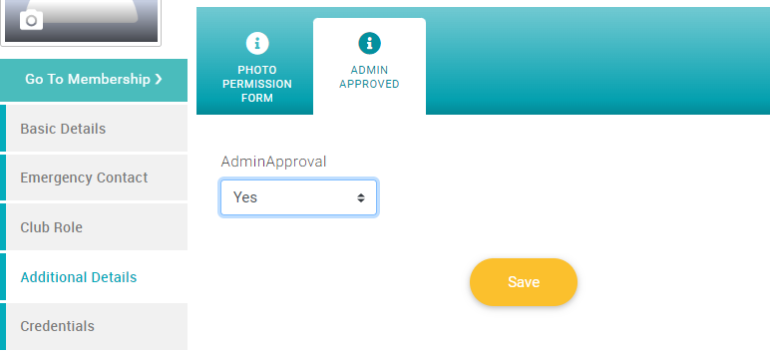
Additional Member Approval Restrictions
To allow the purchase of memberships on a profile, club admins are required to give permission/approval to a member’s profile via “Tick Box” or Yes/No question. These permissions are saved on the members’ profiles, therefore, review of these permissions/approvals are important as we roll into the new membership year.

Slide 13
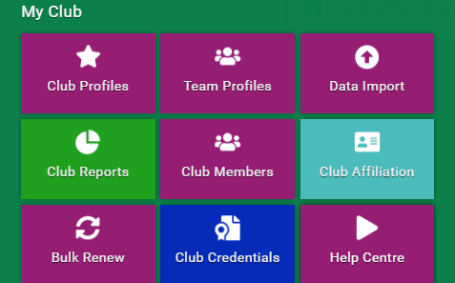
How to reset the permissions/approvals
Permissions/approvals can be reset manually by removing the permissions/approvals from club members’ profiles. Admins will have to go into each member’s profile and review the permissions/approvals.
This can be done through the Club Members tile. Club Members tile > Member profile > Additional details > Club Name > Update the permission/approval > Save.
Note – If the permissions/approvals on members’ profiles are not reviewed then current permissions/approvals will determine if a member can purchase/renew their memberships or not. If you have any questions about resetting or adding these additional restrictions, please contact PCA @ Support@ponyclubaustralia.com.au

Slide 14
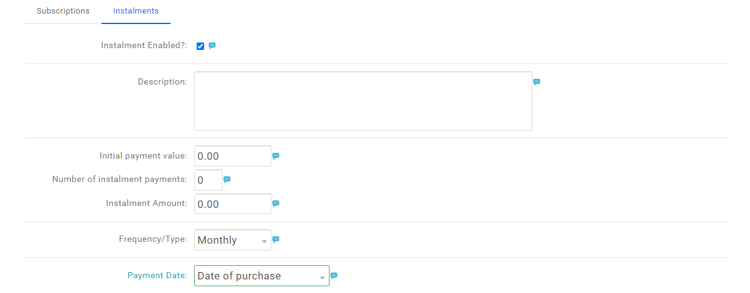
Instalment Setup (JustGo Pro)
Payment instalment setup is only available for the JustGo Pro Clubs. Please note - Instalment payment option will only be available on club membership fees and not on the total membership fees.
Initial Payment Value = The amount required to be paid during the membership purchase.
Number of Instalment Payments = Number of payments after the initial payment.
Instalment Amount = Fixed amount required to be paid for each instalments.
Frequency/Type = This can be weekly, monthly, or quarterly.

Slide 15
Instalment Setup (JustGo Pro)
Payment Date = Various options are available based on the type of frequency.
One of the options is Fixed Date. If fixed date is selected, then a dropdown will appear.
The number of days are not based on the day of the week but are calculated as the days after the initial instalment. For example, if the initial instalment is paid on the 10th of January, then 11th January would be the 1st day and 12th January would be the 2nd day, and so on.
If you have any questions about the instalment payment or not sure about your setup, please contact support@ponyclubaustralia.com.au

Slide 16
Updating Family Membership Prices
Click on “Configure Family Membership” from the Membership Overview page.
Scroll down to Section 2. Please review the family membership combinations and prices. The price mentioned must be the total membership price of all the memberships included in the combination. This is NOT the discounted price but the total membership price.
Once the prices and combinations are updated, please scroll down and click on Save.
If your club/zone having trouble setting up the Family Memberships, please contact PCA at Support@ponyclubaustralia.com.au

Slide 17
14 Months Membership
Pony Club Australia is delighted to announce that the 14 Months Membership period will continue next year too.
The membership will be introduced after the conclusion of the blackout period and any member (new or lapsed) who purchases any memberships except the Come & Try membership will have their membership valid till 31st December 2025. New or Lapsed members now don’t have to wait till 1st January 2025 to purchase/renew their memberships; they can purchase the membership on 12 November 2025 (given the club is ready with their membership setup)
The main purpose of the ‘14 Month Membership’ initiative is to: a) attract new and/or lapsed members late in the membership year when there are still events remaining on the calendar, but full annual membership fees have diminished value. b) this provides a marketing tool for clubs to entice new members to join.
No additional fees will be charged by Pony Club Australia and WA
For any questions or concerns about the “14 Months Membership”, please contact your state body or PCA at Support@ponyclubaustralia.com.au

Slide 18
JustGo Pro
JustGo Essential subscription is provided free as part of club’s registration courtesy of Pony Club Australia, and is proving very successful for many clubs, according to your feedback.
For those wanting the program to do more and make your life easier, PCA has negotiated a very special rate of $125 per year for the ‘JustGo Pro’ package, which will have extended benefits for clubs and members, including:
The ability to offer instalment payments for memberships
Build your own website
Sell uniforms/products and accept donations and sponsorships
Make automatic payments
Record extra, important data like emergency contacts in a ‘membership journey’
You can read more here
http://tinyurl.com/JustGoProforPCA
If you have any queries, or would like to take up the offer, contact PCA (support@ponyclubaustralia.com.au)

Slide 19
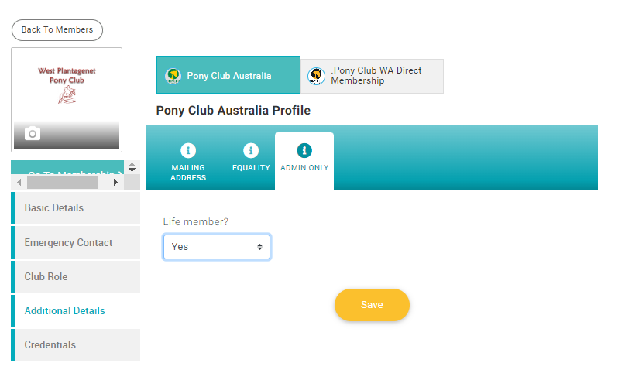
How to add life members
Click on the Club Members tile and search for the member.
Click on Profile and click on “Additional details > Pony Club Australia > Admin only
Click on Life Members > Yes > Save
Life members need to be marked as a Life member in the system for them to see and purchase life memberships.

Slide 20
You’re All Set for 2025!!
Please contact support@ponyclubaustralia.com.au for any questions or concerns.

