Slide 1
Pony club mounted games line stewarding demystified
A SIMPLE GUIDE TO LINE STEWARDING AT PONY CLUB EVENTS

Slide 2
WHY DO WE NEED LINE STEWARDS
Every event needs volunteers to help it run.
Be the eyes and ears to assist the Chief Steward
Ensure the safety of horse and rider is maintained
Ensure the riders are playing by the rules
Ensure the competition is fair
Volunteers make events happen
cant live without them

Slide 3
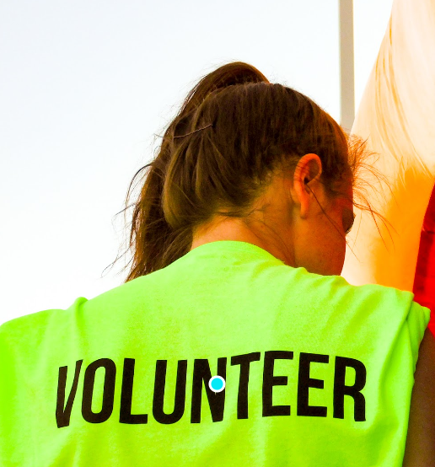
WHO CAN BE A LINE STEWARD
Parents
Friends
Relatives
Anybody over the age of 18

Slide 4
WHAT DO LINE STEWARDS NEED TO DO
Volunteer to be Line Stewards
If Possible attend trainings with their kids to see how the games are run
Attend the Briefings at specified time (Usually 1 hour before flag drop) at competitions
Listen to Chief Steward who will:
Explain the way the day/competition will run
Draw and advise the order of races to be run
Explain the General Rules
Explain the Race Specific Rules
Ask if anyone needs further information or has any questions.

Slide 5
AFTER THE BRIEFING – WHAT TO DO
Make sure you have a drink, hat, sunscreen, rain jacket, closed in shoes etc
Go to the toilet if required – You might be out there for a couple of hours
Collect a coloured vest from officials
Collect a baton or flag from official
Move to a position on the playing field as directed by the Chief Steward
Do not have your mobile phone active
Ensure you are out of the way of play/ponies at all times
Indicate that you are in position and ready to start if asked by Chief Steward

Slide 6
WHERE DO LINE STEWARDS STAND AND WHAT DO THEY LOOK FOR
One each side of the start/finish line
Check to ensure that changeovers happen with all ponies feet behind the lines and that all relevant rules are obeyed.
Check that only the next rider to go takes up position at the start or changeover line. The other riders must remain behind the 6m line.
One each side of the centre line
Check mid field procedures and watch the linkup in pairs games
One each side of the changeover line
Check to ensure that changeovers happen with all ponies feet behind the lines and that all relevant rules are obeyed.
Check that only the next rider to go takes up position at the start or changeover line. The other riders must remain behind the 6m line.
One in the middle behind the changeover line
Watch for rule infringements down the field of play
Watch for interference between the lanes

Slide 7
WHAT TO DO DURING THE COMPETITION
Watch the riders completing the races
Pay particular attention to the riders/teams in your section of the field
If you see something going wrong pay particular attention to what they are doing looking for mistakes and/or corrections.
Do not look at your own child/team as you may miss something in your section.
If you see something that does not look correct raise your flag at the end of the race.
If not sure give the benefit of the doubt to the rider.
Converse with the Chief Steward and tell them exactly what you saw and what you think happened.
The Chief Steward will make a decision on what action to take based on Line Steward and their own observations.

Slide 8
WHAT TO DO DURING THE COMPETITION - continued
After each race the Chief Steward will look around the field to ask all the Line Stewards of they are all good.
If none of the line stewards have a raised flag the Chief Steward will blow the whistle and the arena party will commence setting up the next race.
Line Stewards will rotate in a clockwise direction after each race.
Be mindful of not standing in front of the scorers/judges on Start/Finish Line
Line Stewards should report any person who questions their decisions or is abusive etc.
Line Stewards are usually swapped out half way through the competition.
Its good to have someone from your team that will swap with you.
Make sure you either hand your vest and flag to your replacement or back to the official trailer after you have finished your shift.

Slide 9
WHEN SHOULD YOU RAISE YOUR FLAG - GENERAL RULES
If a horse is hit with a piece of equipment by a rider.
If a rider puts something in their mouth.
If a team does not correct their mistakes during a game.
If a rider loses their pony and does not return to where they lost it to resume game
If a rider does not weave around the poles correctly
If a rider knocks a pole down and does not stand it up
If more than one rider enters the start box at a time – that rider must go next
If all 4 hoofs of both riders’ ponies are not behind the line during handover
If outgoing rider picks up dropped pass instead of incoming rider
If a rider or loose pony interferes with another rider/team
If you think a rider is riding roughly or dangerously or swearing or acting inappropriately
Riders must be mounted – astride in the saddle when crossing the line

Slide 10
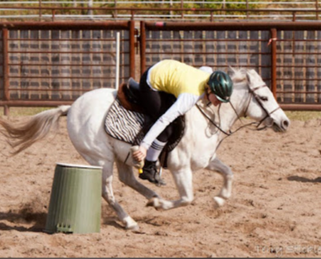
WHAT SHOULD YOU WATCH OUT FOR– 2023 RACE SPECIFIC RULES
Bottle Race
Bottles replaced correctly on drums if dropped
Litter Race
Litter to be picked up mounted/ not touched by the hands
If Litter jammed on stick rider may use hand to loosen it
If piece of litter that rider is trying to pick up passes over line into playing field they must pick up that piece
If litter is dropped off stick, rider must pick it up mounted with the stick
If litter is dropped out when or after attempting to place in bin, it may be picked up and put in bin dismounted with the stick
If bin is knocked over and litter falls out, rider may put the litter back in with their hands dismounted.
If litter stick is broken, rider may continue to use broken stick to pick up litter.
Watch out for interference in other lanes if riders attempting to pick up litter out of their lane

Slide 11
WHAT SHOULD YOU WATCH OUT FOR– 2023 RACE SPECIFIC RULES
Five Flag Race
If a flag holder is knocked over, rider must put it up again with all remaining flags in it
If a rider picks up more than 1 flag, they must put excess flags back in holder before continuing – may do this dismounted
If flag comes off the stick, rider can continue with just the stick
Flags can be placed in cone either way up
Pony Club Pole Race
Letters must be placed on pole in correct order to spell PONYCLUB with top to bottom
Letters must be right way up

Slide 12
WHAT SHOULD YOU WATCH OUT FOR– 2023 RACE SPECIFIC RULES
Tyre Race
At each changeover the next pony must remain behind the line until both previous ponies have crossed the line
The rider who is holding the pony must have hold of the reins of the other pony before the other rider can let go of the reins and get through the tyre
Riders must not run while getting through the tyre
If a pony runs away it must be bought back to where it ran away from to resume the race
Watch out for interference with other riders/lanes especially if a pony gets loose.
Ball and Bucket Race
If the bucket is knocked over at any time, it must be stood up and any balls replaced back in it before proceeding. This can be done mounted or dismounted.
If ball bounces out of bucket it must be picked up and put into bucket – can be done mounted or dismounted if attempt has been made to put it in.
Last rider must drop last ball into bucked on way home

Slide 13
WHAT SHOULD YOU WATCH OUT FOR– 2023 RACE SPECIFIC RULES
Pony Express Race
Rider must not dismount till after the 2nd bending pole
Mail must be in sack before rider mounts
Rider must remount before the 3rd bending pole
Riders must continue the same weave between poles after remounting
Make sure no mail drops out of the sack during the race
Rope Race
Riders must bend on same side of poles keeping hold of the rope
If a rider lets go of 1 end of the rope both riders must go back to where it happened and resume with both holding the rope
Rope must not be knotted or looped
Poles knocked down may be replaced by either rider

Slide 14
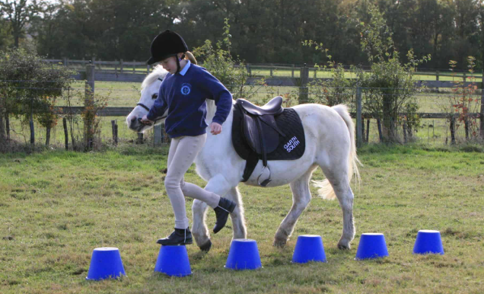
WHAT SHOULD YOU WATCH OUT FOR– 2023 RACE SPECIFIC RULES
Stepping Stone Dash
Riders must dismount, step onto the ground, step on each stepping stone and then onto the ground leading their pony before remounting
If a rider or pony knock over a stepping stone or the rider treads on the ground while crossing the stones, they must reset the fallen stone/s and return to cross all of the stones again in either direction
If the rider or pony knocks a stone AFTER crossing the stones, the rider just needs to reset the stone/s before continuing
Riders must lead their pony with the nearest rein WITHOUT
leaning on the pony.
Reins must remain over the neck of the pony

Slide 15
WHAT SHOULD YOU WATCH OUT FOR– 2023 RACE SPECIFIC RULES
Sharp Shooters
Rider 2 must mount before crossing start line
Rider 1 leads pony across centre line
Rider 2 must throw ball into net from behind changeover line
Rider 1 must mount before re-crossing centre line
Same rules apply for riders 3 and 4
If team runs out of balls team member runs forward with the bucket to collect them and then continue the race from behind the changeover line as before
Ponies must be lead by the nearer rein during the race

Slide 16
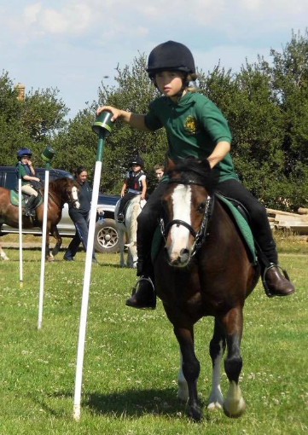
WHAT SHOULD YOU WATCH OUT FOR– 2023 RACE SPECIFIC RULES
Two Mug Race
Riders must ride straight and don’t need to bend
If a mug is dropped off a post, it must be replaced before continuing
If a post is broken team will be eliminated
Mugs must be placed on the designated pole in the correct order
Wizards Castle Race
Swords must be held behind the handle
All equipment must be upright in the correct position before the rider can continue
This can be done mounted or dismounted

Slide 17
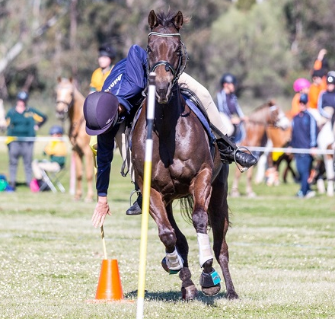
WHAT SHOULD YOU WATCH OUT FOR– 2023 RESERVE RACE SPECIFIC RULES
Team Bending Race
Poles knocked down must be replaced by the rider who knocked them down
Poles only need to be replaced if they are flat down on the ground
If the poles are broken they cannot be replaced so the team will be eliminated
Ball & Flag
If cones are knocked over or balls and/or flags are dropped,
all equipment must be righted before the race can continue

